Slide 1
Secure Data Hiding in Image using Steganography
CAPSTONE PROJECT
Presented By: Ayush Singh
Student Name : Ayush Singh
College Name & Department : Kashi Institute of Technology, Varanasi CSE (AI&ML) Department

Slide 2
OUTLINE
Problem Statement
Technology used
Wow factor
End users
Result
Conclusion
Git-hub Link
Future scope

Slide 3
Problem Statement
Sending sensitive messages in plaintext is traditional but not safe. To overcome this issue, we can use steganography.
The objective of this project is to hide sensitive messages into image by using the technique of steganography in python programming language.

Slide 4
Technology used
Programming Language: Python
Libraries:
Open CV (cv2): This library is used for image pixel manipulation for hiding sensitive data into the image
OS (os): This python library is used to open the encrypted image file.
IDE: V.S Code
Operating System: Windows 11

Slide 5
Wow factors
Some of the wow factors about this project are:
The project is divided into two parts encrypt.py and decrypt.py making it easier to hide and unhide sensitive messages.
The hidden sensitive message when extracted is also saved into a text file for user ease to read in future.
The sensitive message is hidden into the blue channel of the image because changes in blue spectrum are less likely to be detectable by human eyes in comparison to red and green channels.

Slide 6
End users
This steganography tool can be used by anyone who want to communicate some sensitive information with someone without being known by any third person. Some of the end users are who can use this tool are:
Military: It can be used by military officers to hide sensitive information about nation security which must be kept hidden from rival country.
Cybersecurity Professionals: Cybersecurity professionals can use this tools to hide sensitive information to make it harder to be detected by unauthorized persons.
Journalists: Journalists can use this tool to share sensitive information securely.
Everyday User: A normal netizen can use this tool to keep safe their sensitive messages.

Slide 7
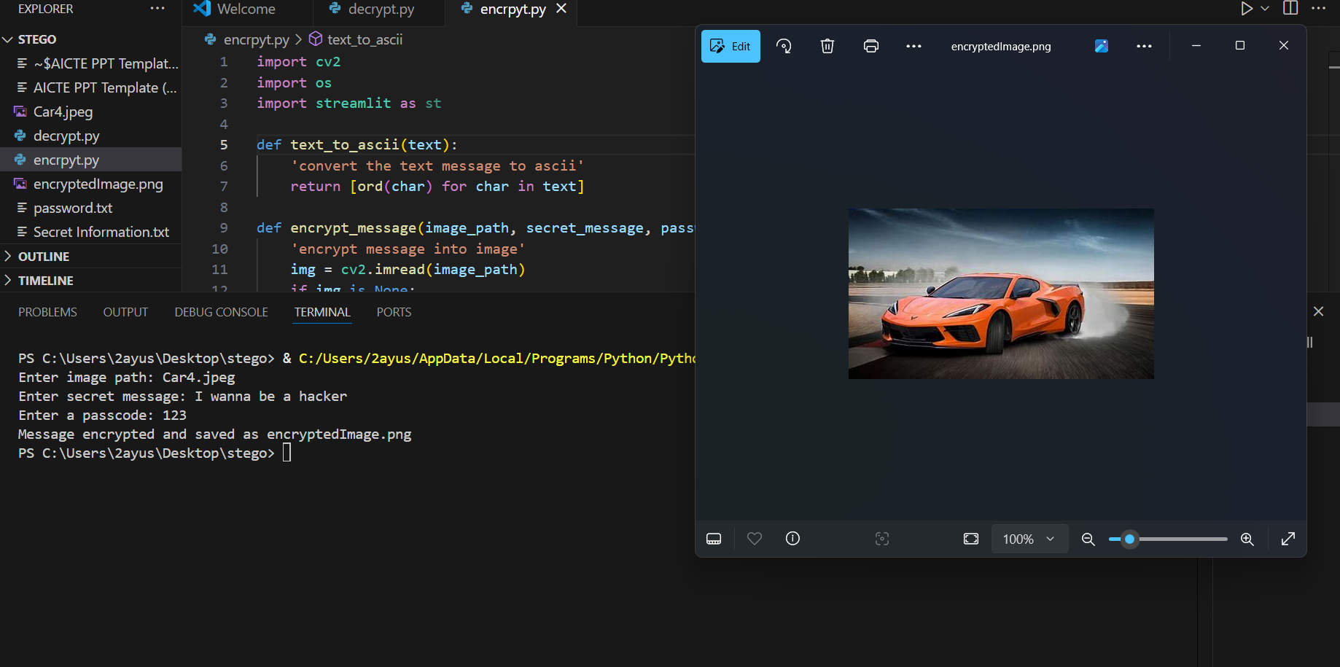
Results
Image 1: Hiding the Message

Slide 8
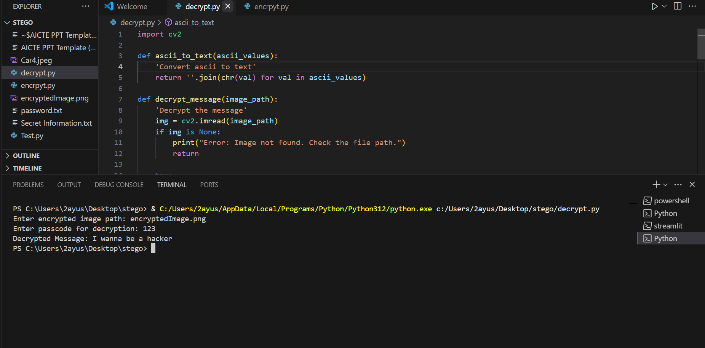
Image 2: Un-hiding the secret Message

Slide 9
Conclusion
Sending sensitive messages in plaintext is traditional but not safe. To overcome this issue, we can use steganography.
The Steganography tool is developed to easily hide and unhide messages by providing a very simple command line user interface. It is a very easy to use. Encrypt.py file can be easily used by students or professionals to hide sensitive messages into images making the sensitive message undetectable by a normal person.
The same sensitive information can be extracted by using Decrypt.py file.

Slide 10
GitHub Link
GitHub Link: ayushSingh0112/AICTE-Edunet-Internship-Steganogrphy

Slide 11
Future scope(optional)
The current version of this tool can be used through CLI (Command line Interface) to make it more user friendly GUI (Graphical User Interface) can be implemented.
To make the password more secure, the password can be stored in encrypted format using hashing.
Least Significant Bit (LSB) can be modified for stealthier hiding.
This tools can be converted to desktop application and smartphone application for easy availability and use.

Slide 12
THANK YOU

